Slide 1
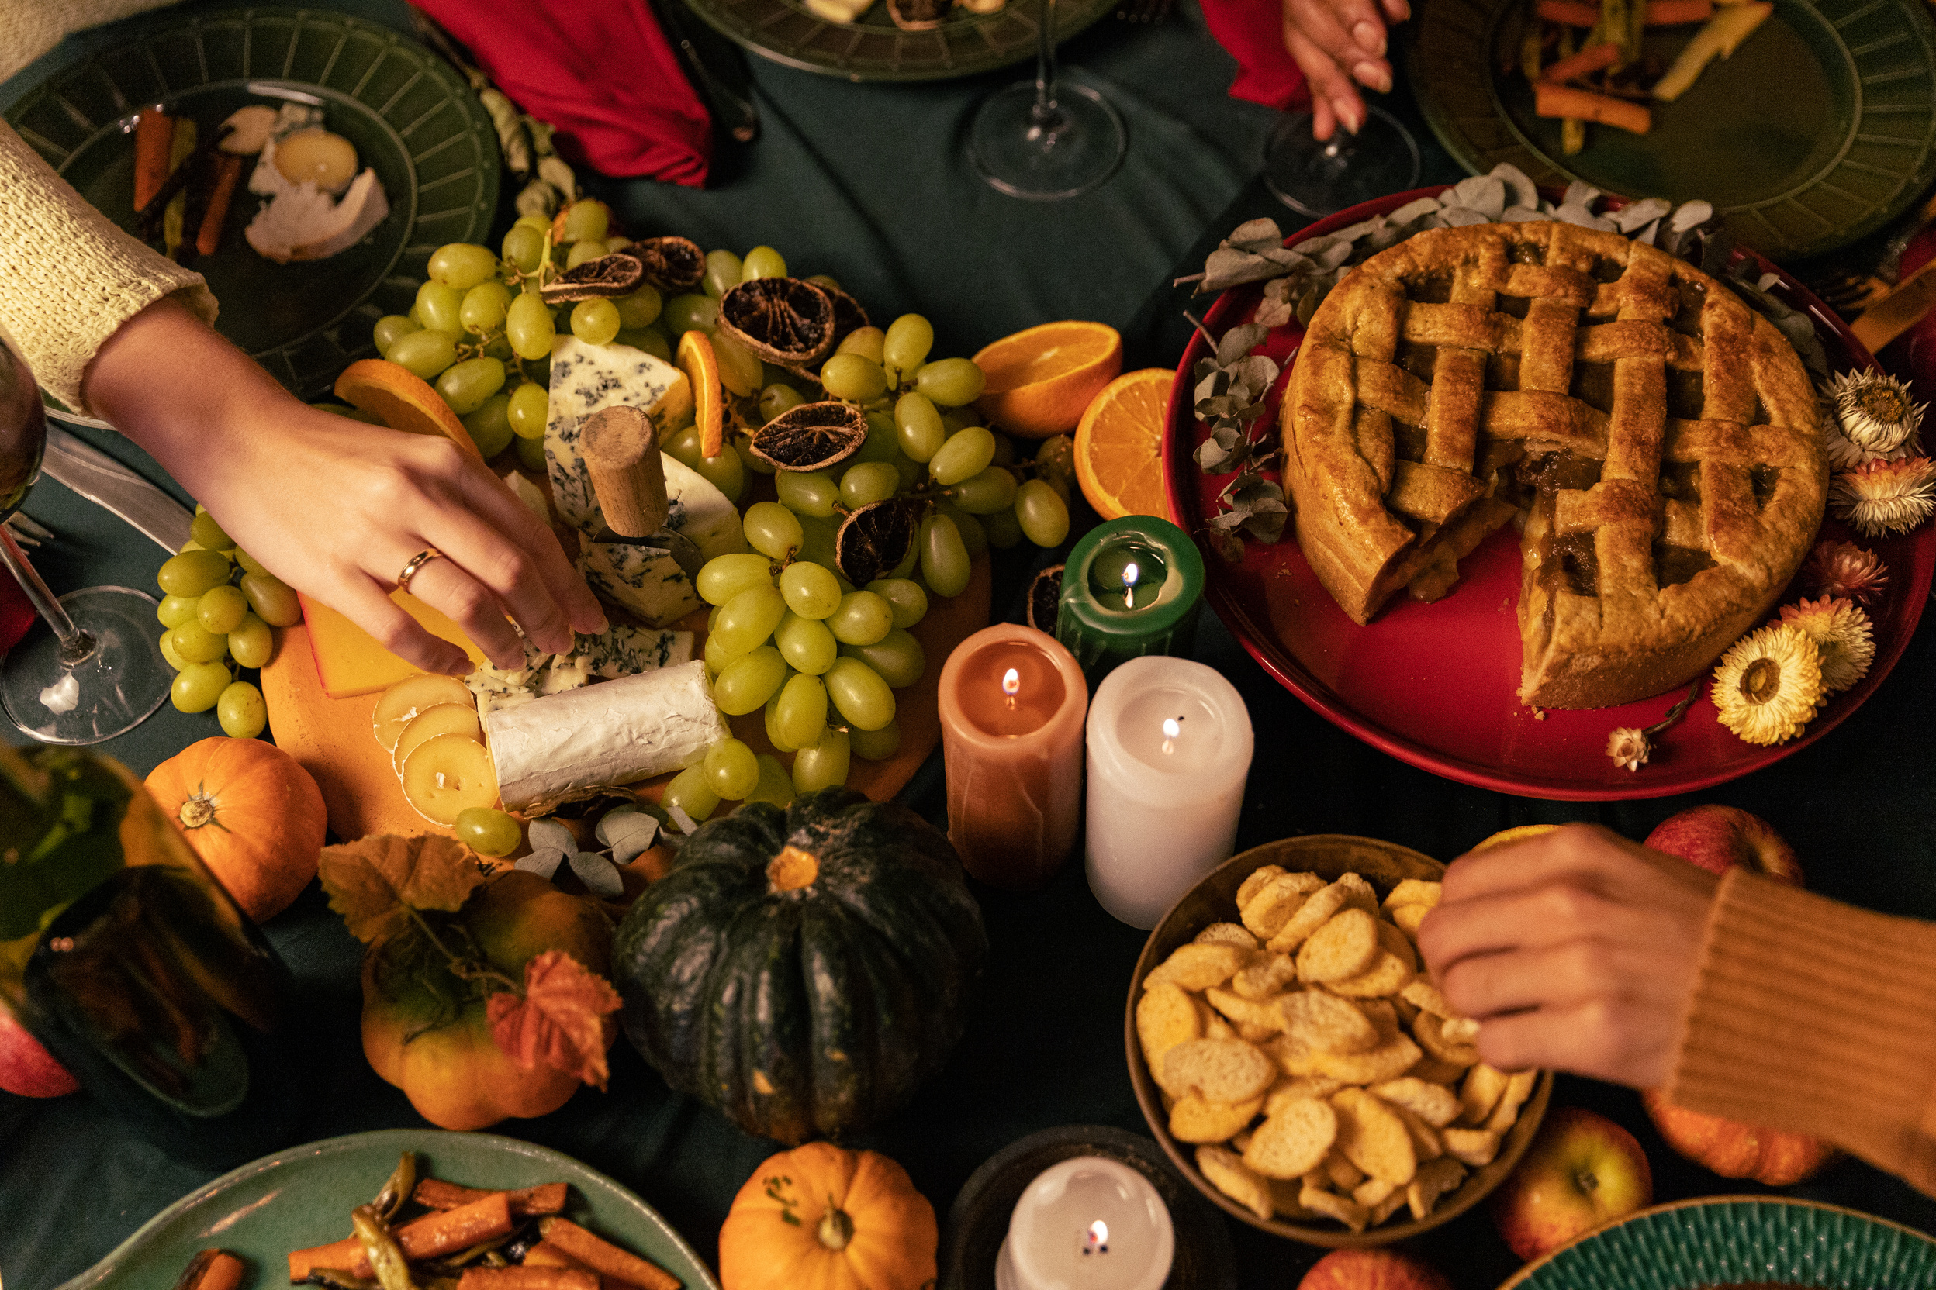

November 2024
END-OF-YEAR ASK WORKSHOP
EASY AS P.I.E. (Plan, Invite, Engage)

Slide 2
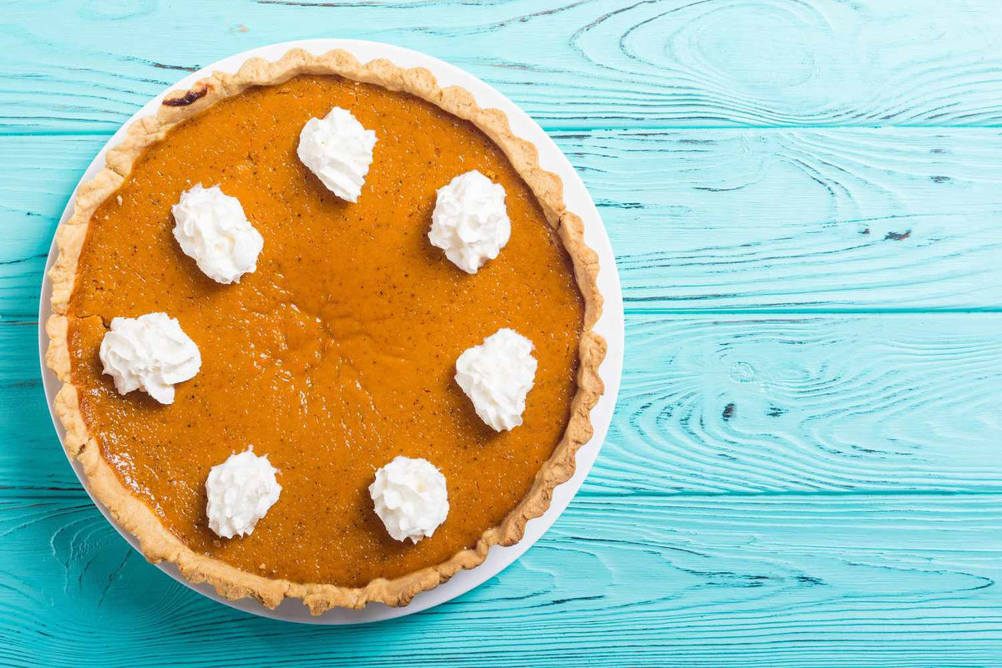
INTRO
DUCTIONS
WHO ARE YOU?
WHAT IS YOUR MINISTRY?
WHAT IS ONE THING YOU DO FOR FUN?
“The more I know about people, the more I like my dog.” - Mark Twain

Slide 3
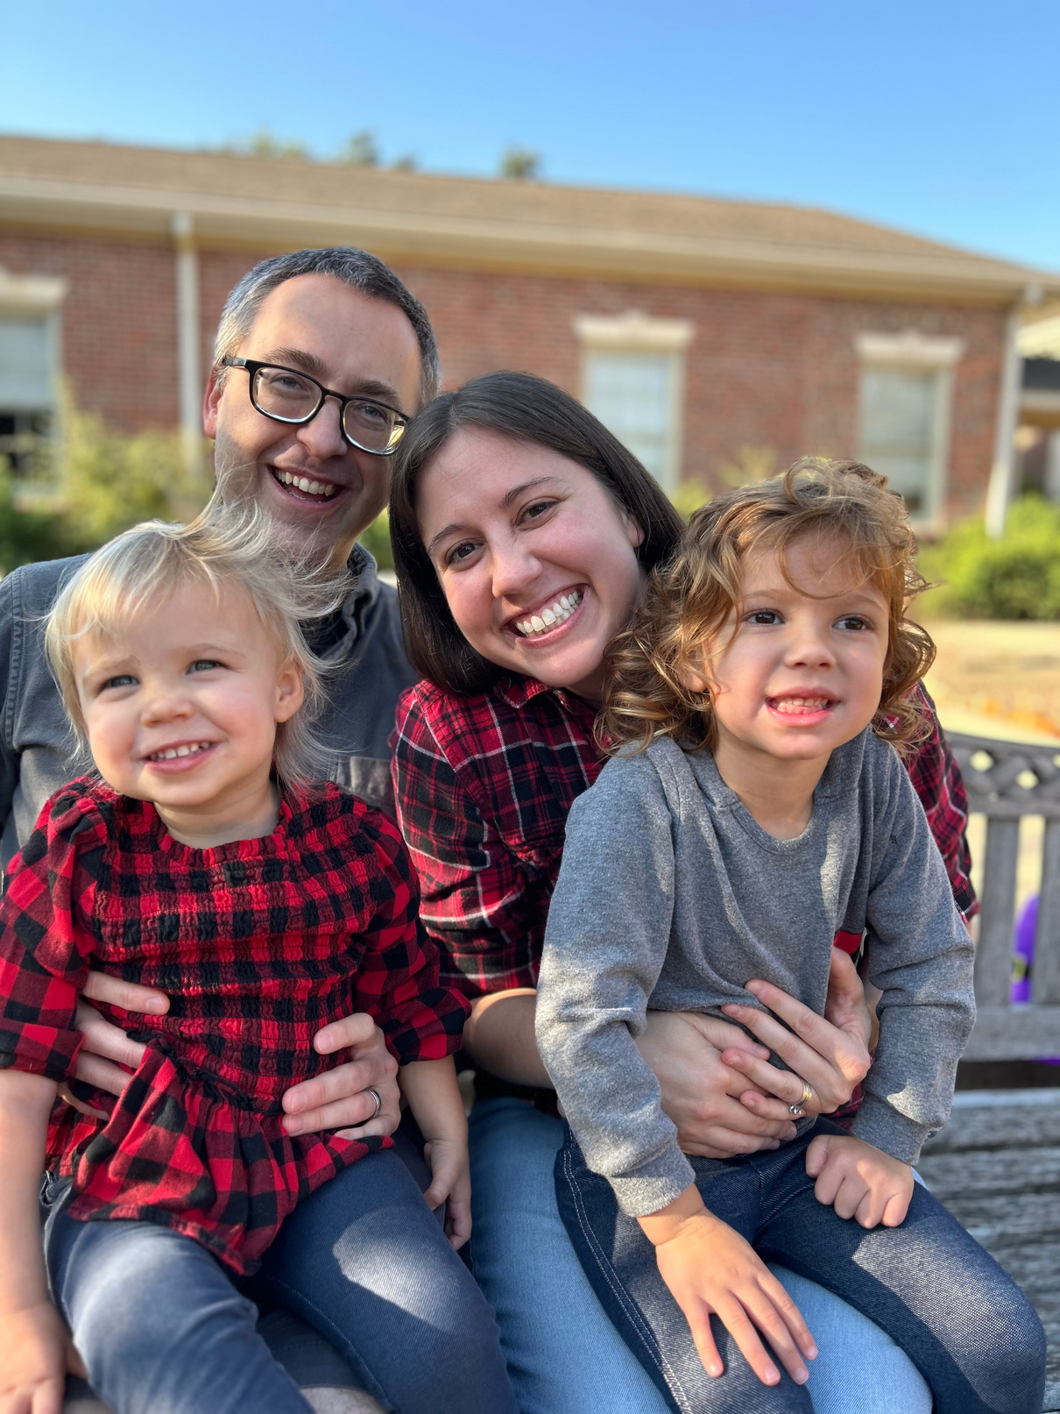
WHY SHOULD YOU LISTEN TO ME?
Jenni Saniuk | MTD Guru
  6 years fully funded in the field
  6 years working at Reliant Central
  Seen God move in amazing ways through fundraising
  Passionate about helping people get to where they want to be in ministry.
"An invitation is the beginning of a story; the rest is up to those who choose to come." – Unknown

Slide 4
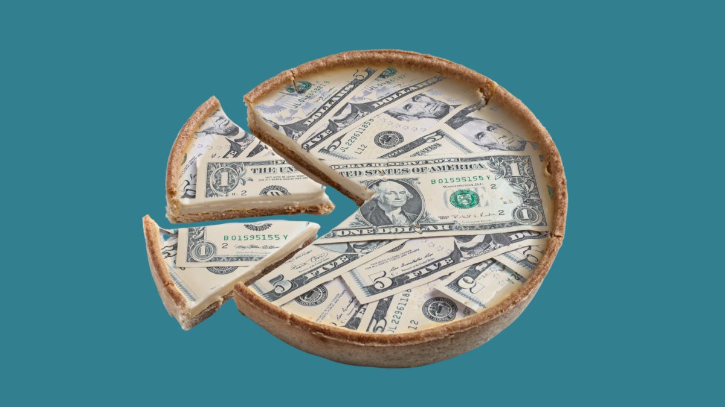
THE IMPACT OF EOY
THE IMPORTANCE OF THE END-OF-YEAR PERIOD (GIVING SEASON)
  30% to 40% of annual giving happens in the final months of the year.
    nearly 30% of all charitable donations in the U.S. are made in December, with the peak occurring between #GivingTuesday and December 31st.
    10% OF ALL GIVING HAPPENS IN THE LAST THREE DAYS OF THE YEAR (DECEMBER 29-31), SHOWING THE CRITICAL TIMING OF THE END-OF-YEAR GIVING SURGE.
“The best way to find yourself is to lose yourself in the service of others.”
— Mahatma Gandhi

Slide 5
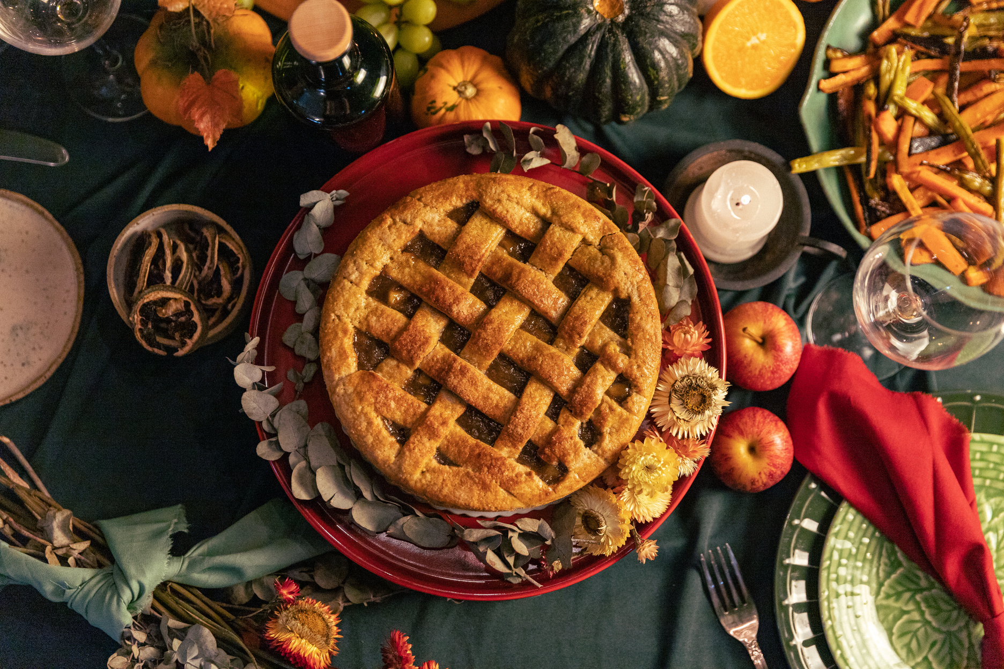
STEP 1: PLAN
The Who
The What
The WHY
  Why are you doing an EOY ask?
  What is the “Need” you want to put in front of others?
  Who do you want to ask?
"A goal without a plan is just a wish." – Antoine de Saint-Exupéry

Slide 6

STEP 2: INVITE
People give when ASKED
  Something tangible makes a difference
  Send out before Thanksgiving
  Take the time to make this special
(Christmas card, ornament, etc)
  Remind your donors of all that God has done in this last season
"An invitation is the beginning of a story; the rest is up to those who choose to come." – Unknown

Slide 7
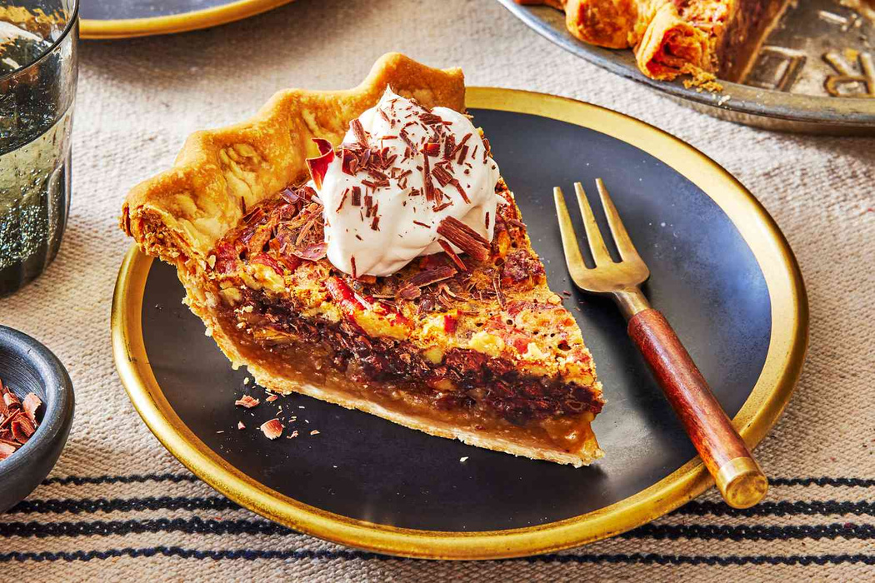

STEP 3: ENGAGE
Finish up with follow up
  Three check-ins before the end of the year
    Giving Tuesday
    December 15th
    December 29th
  Can be simple written texts over phone calls.
  Make it personal and direct.
"A mission is only as strong as the number of hearts willing to carry it forward." – Unknown

Slide 8

QUESTIONS?
COMMENTS?
GOOD DAD
JOKES?
"The only limits that exist are the ones you place on yourself. So go ahead, crush it!"– Unknown

