Slide 1

Better
together
  How to get the most
  from your Aetna International benefits
1052950 - 01 (3/22)

Slide 2
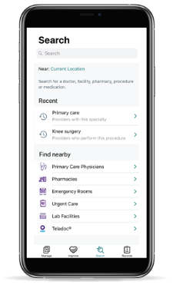


Manage your benefits right from your phone
Use the Aetna HealthSM app when you're inside the U.S.
Find doctors, hospitals, urgent care centers and walk-in clinics in the U.S.
Estimate costs
Track claims
Access your digital member ID card
Use the International Mobile Assistance app when you're outside the U.S.
Submit claims
Search for doctors and hospitals outside the U.S.
Find forms, health care resources and more

Slide 3
Claims processing
Claim adjudication system experts
Translation services available in-house
Reimbursement options: Electronic Funds Transfer (EFT), wire and check
Reimbursement can be made in more than 170 currencies
Aetna International will not assess a member for any fees to process a wire
Reimbursement directly to any bank account, except for in sanctioned countries
Submit claims by mail or online through the secure member website or Aetna International mobile app
Members can monitor claims status online once enrollment is confirmed
Submitting a claim
1
2
3
Mail
Online
App

Slide 4

A few claim tips
When claims are required:
If you choose a doctor in our direct settlement network, you can usually access care without having to submit a claim.
If you choose to go outside the network for care, you'll need to pay at the time of service and then submit a claim for reimbursement.
Before you submit your claim:
You'll need to submit your claim within 180 days of your treatment.
Have all supporting documents on hand, including original receipts, certificates and X-rays.
Put your member ID number on each document you submit.
Be ready to provide complete details of your visit, including the reason for it and a description of services provided.
Know what currency and method — check, wire or electronic funds transfer (EFT) — you'd like to be reimbursed in. (We don't charge processing fees for EFT, wire transfers or direct deposits, but your bank might, so make sure you check.)

Slide 5

Getting to know your secure member website

Slide 6
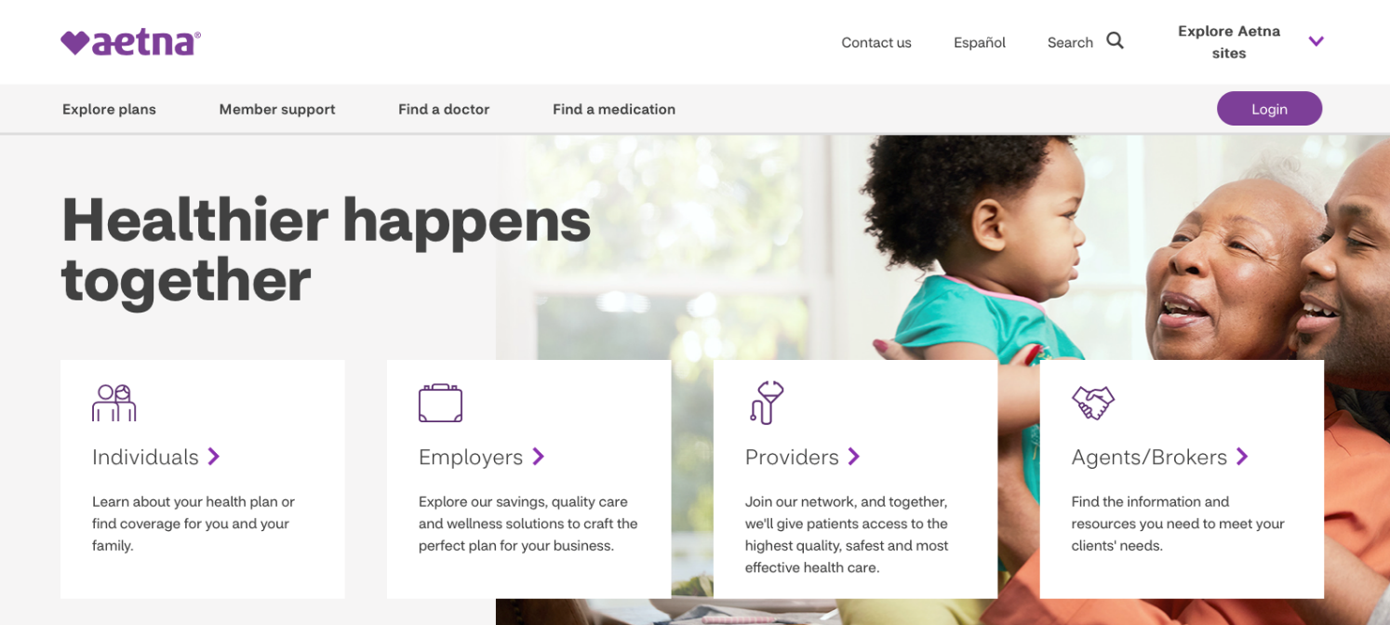
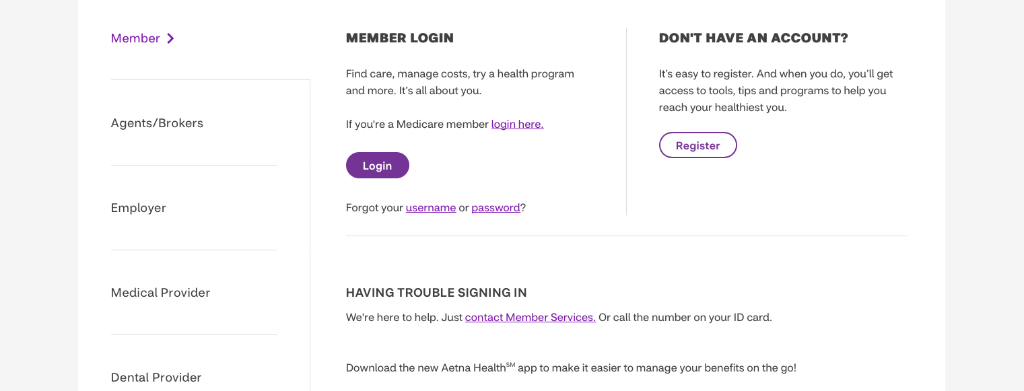
Login or register
Go to Aetna.com, Click on “Login”
If you’re a new member or haven’t registered yet, click the “Register” button and follow the instructions.
If you’re an existing member and have already registered — enter your username or email and password details in the boxes provided.

Slide 7
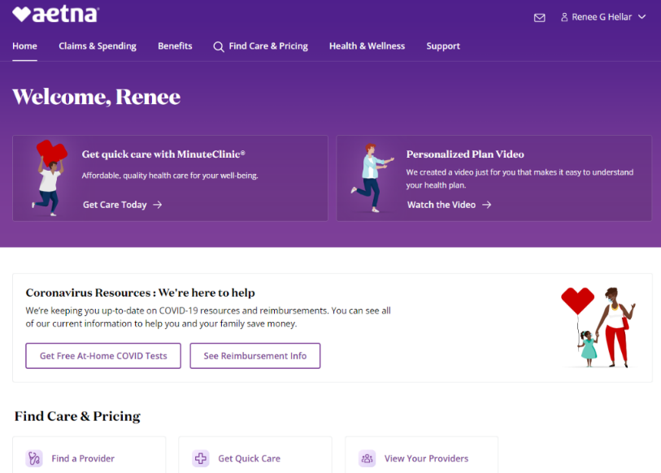
Aetna.com
Aetna.com gives you access to view your member ID card, search for providers inside the U.S., view online claim status and more.
Go to AetnaInternational.com to submit claims as well as locate providers and facilities OUTSIDE the U.S.
Use the Aetna Health app when you're inside the U.S.
Find doctors, hospitals, urgent care centers and walk-in clinics
Estimate costs
Track claims
Access your digital member ID card
Use the International Mobile Assistance app when you're outside the U.S.
Submit claims
Search for doctors and hospitals
Find forms, health care resources
and more

Slide 8
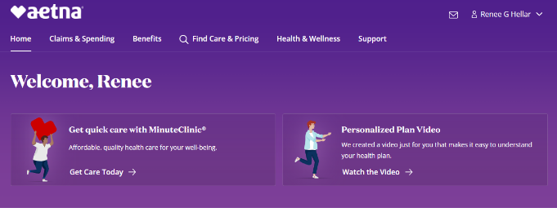
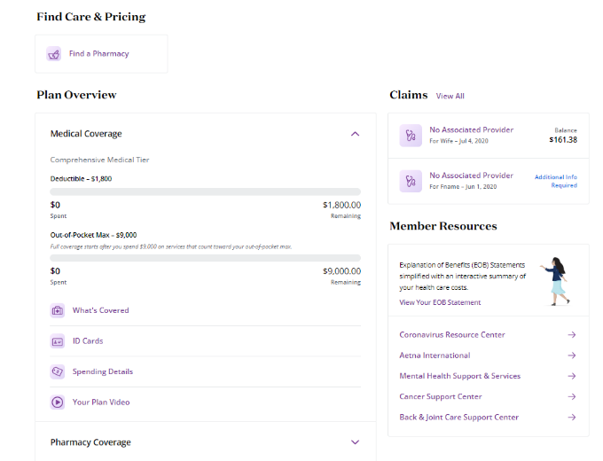
Aetna.com — where to go to submit a new claim
From your Aetna.com home page scroll down and click Aetna International to go to AetnaInternational.com to submit new claims and find providers OUTSIDE the U.S.

Slide 9
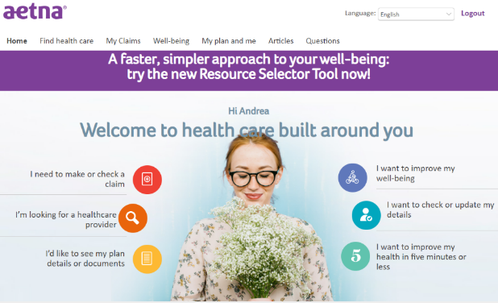

AetnaInternational.com — home page
Main navigation located at the top of the page.
Banner messaging highlighting the latest updates and features available for members.
Task-driven navigation centered around a regionalized image.

Slide 10
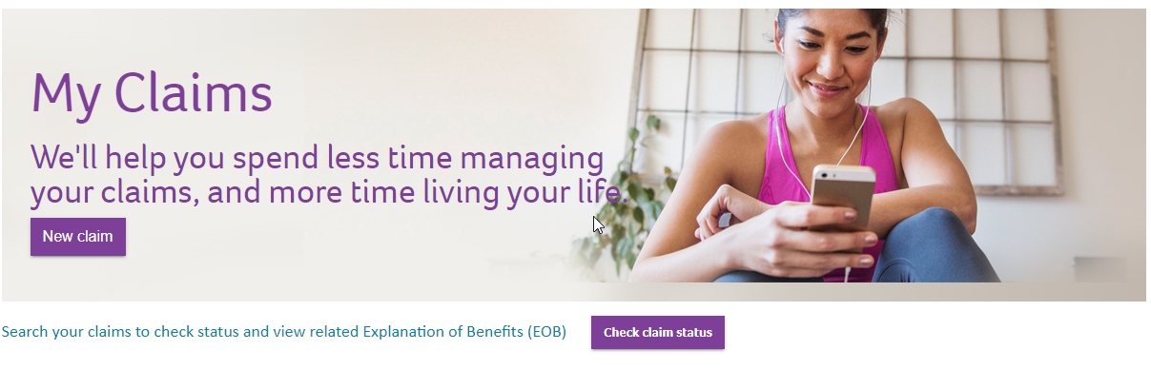
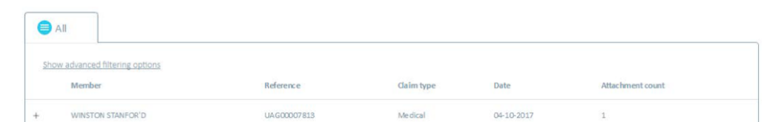
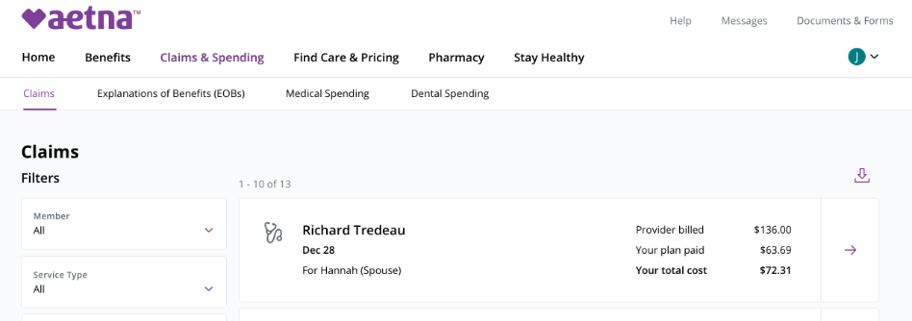
AetnaInternational.com — submitting claims
Submit a new claim by clicking “New Claim” then follow the instructions for the requested information.
View the status of your claims and your Explanation of Benefits by clicking this button — it’ll take you here.
Filter your claims by member name, provider name, etc.

Slide 11
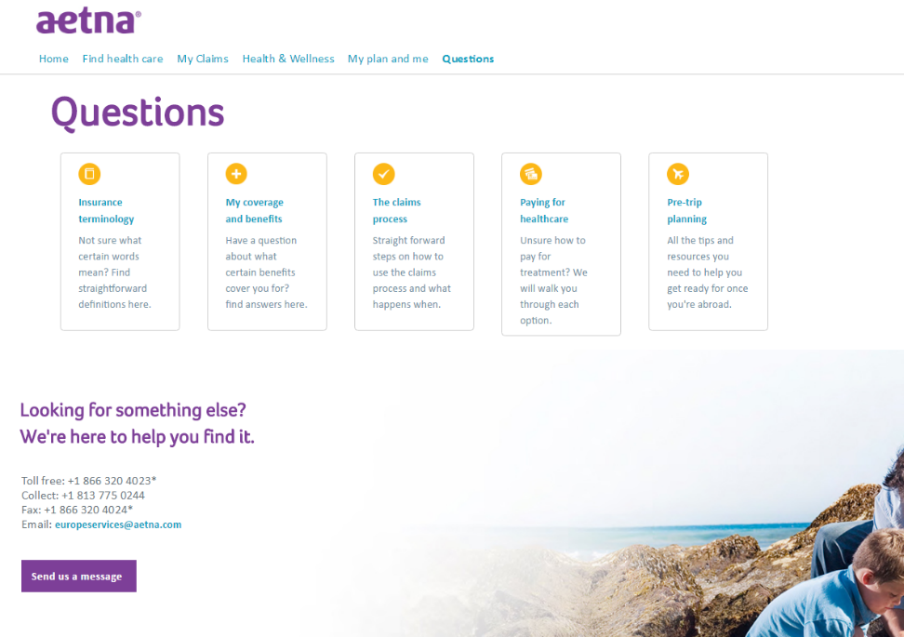
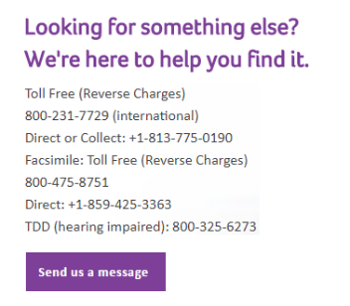
Questions
Get answers to our most frequently asked questions here.
If you can’t find what you need, we’re available 24/7.
Use the contact information to call us or send us a message with a web form.

Slide 12
Aetna® is a trademark of Aetna Inc. and is protected throughout the world by trademark registrations and treaties. Plans and programs are underwritten or administered by Aetna Life Insurance Company or Aetna Life & Casualty (Bermuda) Ltd.
Aetna does not provide care or guarantee access to health services. Not all health services are covered. Health information programs provide general health information and are not a substitute for diagnosis or treatment by a health care professional. See plan documents for a complete description of benefits, exclusions, limitations and conditions of coverage. Information is believed to be accurate as of the production date; however, it is subject to change. Refer to AetnaInternational.com for more information.
If coverage provided by this policy violates or will violate any U.S., U.N., E.U. or other applicable economic or trade sanctions, the coverage is immediately considered invalid. For example, Aetna companies cannot make payments or reimburse for health care or other claims or services if it violates a financial sanction regulation. This includes sanctions related to a blocked person or entity, or a country under sanction by the United States, unless permitted under a valid written Office of Foreign Assets Control (OFAC) license.

